Slide 1

Data Visualization using

Slide 2
Key Points to be covered..
Introduction to Power BI
Creating, Managing and Filtering Data
Basic Plots in Power BI
Creating Power BI Reports
Trend Analysis
Area Plot
Ribbon plot
Scatter Plots
Decomposition Trees
Creating Interactive Dashboard and Deploying the Dashboard

Slide 3

Power BI Architecture, Components, and Products

Slide 4
Power BI Offerings
You can choose from four different products that suit your need. They are:
Power BI
Power BI Desktop Power BI Mobile Power BI Embedded

Slide 5
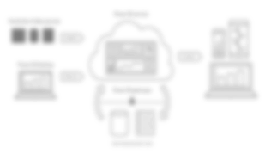
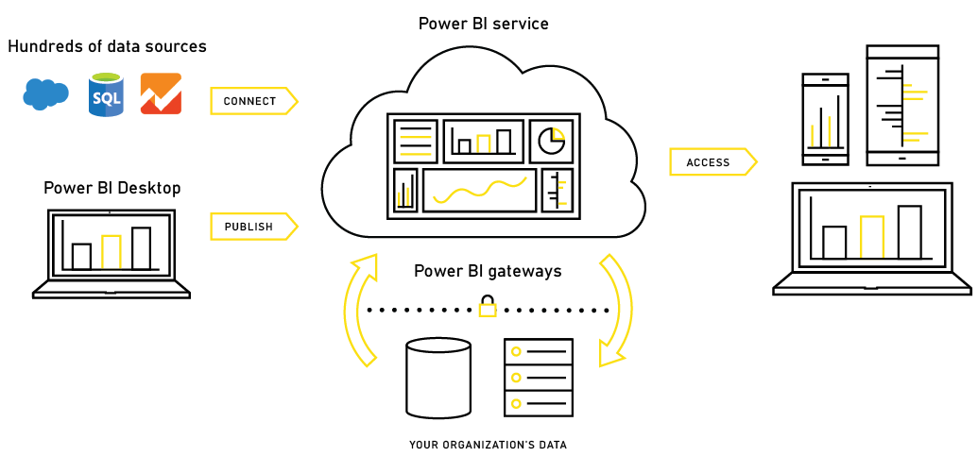
Power BI Desktop Architecture

Slide 6
Power BI Desktop Components
Power BI Desktop uses three components to perform different operations. They are:
Power Query
Power Pivot Power View

Slide 7

Power BI Desktop Components—Power Query
Power BI Desktop uses Power Query to:
Store the results in an excel file or in a Power Pivot model
Perform data transformation

Slide 8

Power BI Desktop Components—Power Pivot
With Power Pivot you can:
Perform data modeling
Build a schema, relationships, and so on
Create user- defined fields

Slide 9

Power BI Desktop Components— Power View
Power View allows you to:
Connect to different data sources
Add interactivity
Create views

Slide 10
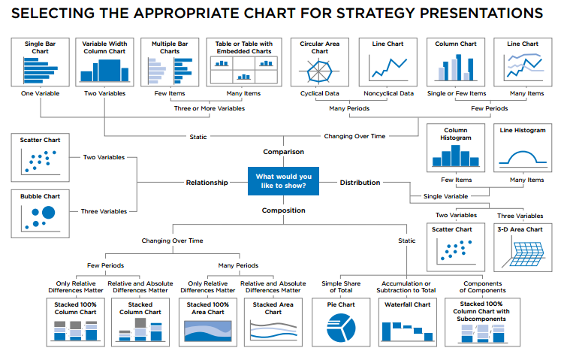
Types of visualizations

Slide 11

Installation

